Slide 1

KAFKA

Slide 2
CONTENTS
Introduction to Streaming
Introduction to Kafka
Kafka Fundamentals
Topics/Brokers/Consumer/Producer

Slide 3
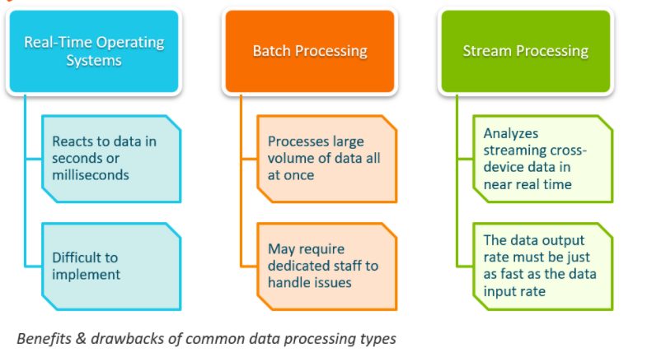

Slide 4
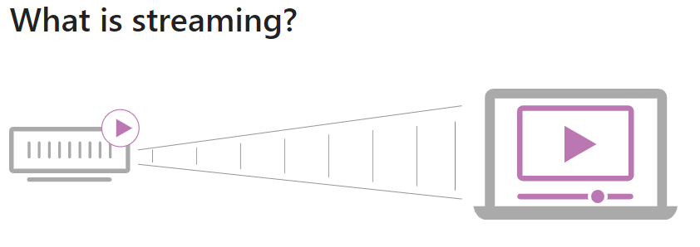


Slide 5
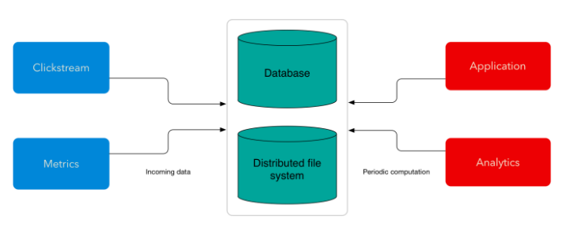
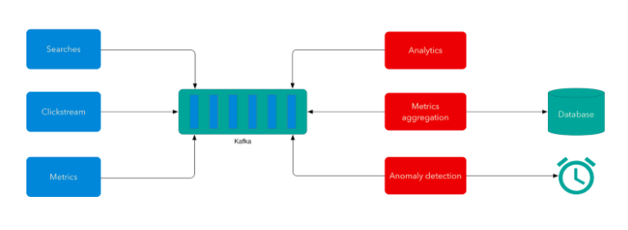

Slide 6
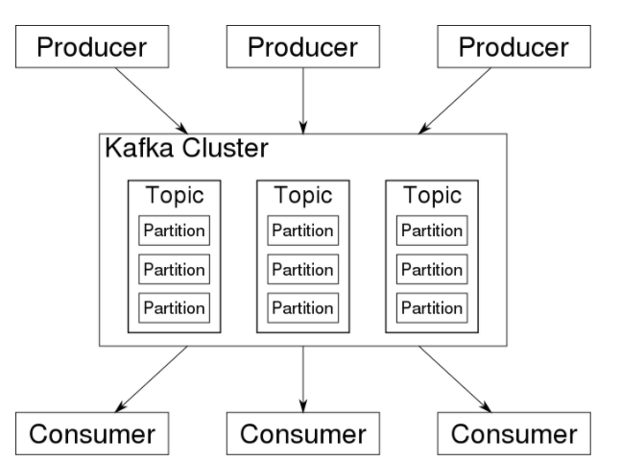

Slide 7
Introduction to Streaming
Kafka Streams is a library for building streaming applications, specifically applications that transform input Kafka topics into output Kafka topics (or calls to external services, or updates to databases, or whatever).
It lets you do this with concise code in a way that is distributed and fault-tolerant.
Stream processing is a computer programming paradigm, equivalent to data-flow programming, event stream processing, and reactive programming, that allows some applications to more easily exploit a limited form of parallel processing.

Slide 8
A stream is the most important abstraction provided by Kafka Streams: it represents an unbounded, continuously updating data set, where unbounded means “of unknown or of unlimited size”.
A stream partition is an, ordered, replayable, and fault-tolerant sequence of immutable data records, where a data record is defined as a key-value pair.

Slide 9
Kafka Streams simplifies application development by building on the Apache Kafka producer and consumer APIs, and leveraging the native capabilities of Kafka to offer data parallelism, distributed coordination, fault tolerance, and operational simplicity.
Here is the anatomy of an application that uses the Kafka Streams API.
It provides a logical view of a Kafka Streams application that contains multiple stream threads, that each contain multiple stream tasks.

Slide 10
Introduction to Kafka
Apache Kafka is an event streaming platform used to collect, process, store, and integrate data at scale. It has numerous use cases including distributed logging, stream processing, data integration, and pub/sub messaging.
In order to make complete sense of what Kafka does, we'll delve into what an "event streaming platform" is and how it works.
So before delving into Kafka architecture or its core components, let's discuss what an event is.
This will help explain how Kafka stores events, how to get events in and out of the system, and how to analyze event streams.

Slide 11
What are Events?
An event is any type of action, incident, or change that's identified or recorded by software or applications. For example, a payment, a website click, or a temperature reading, along with a description of what happened.
In other words, an event is a combination of notification—the element of when-ness that can be used to trigger some other activity—and state.
That state is usually fairly small, say less than a megabyte or so, and is normally represented in some structured format, say in JSON or an object serialized with Apache Avro™ or Protocol Buffers.

Slide 12
Kafka and Events - Key/Value Pairs
Kafka is based on the abstraction of a distributed commit log.
By splitting a lot into partitions, Kafka is able to scale-out systems. As such, Kafka models events as key/value pairs.
Internally, keys and values are just sequences of bytes, but externally in your programming language of choice, they are often structured objects represented in your language’s type system.
Kafka famously calls the translation between language types and internal bytes serialization and deserialization. The serialized format is usually JSON, JSON Schema, Avro, or Protobuf.

Slide 13
Values are typically the serialized representation of an application domain object or some form of raw message input, like the output of a sensor.
Keys can also be complex domain objects but are often primitive types like strings or integers.
The key part of a Kafka event is not necessarily a unique identifier for the event, like the primary key of a row in a relational database would be. It is more likely the identifier of some entity in the system, like a user, order, or a particular connected device.
This may not sound so significant now, but we’ll see later on that keys are crucial for how Kafka deals with things like parallelization and data locality.

Slide 14
Why Kafka?
Benefits and Use Cases
Kafka is used by over 100,000 organizations across the world and is backed by a thriving community of professional developers, who are constantly advancing the state of the art in stream processing together.
Due to Kafka's high throughput, fault tolerance, resilience, and scalability, there are numerous use cases across almost every industry - from banking and fraud detection, to transportation and IoT.

Slide 15
We typically use Kafka for purposes like these:
Data Integration
Kafka can connect to nearly any other data source in traditional enterprise information systems, modern databases, or in the cloud.
It forms an efficient point of integration with built-in data connectors, without hiding logic or routing inside brittle, centralized infrastructure.
Metrics & monitoring
Kafka is often used for monitoring operational data.
This involves aggregating statistics from distributed applications to produce centralized feeds with real-time metrics.

Slide 16
Log aggregation
A modern system is typically a distributed system, and logging data must be centralized from the various components of the system to one place.
Kafka often serves as a single source of truth by centralizing data across all sources, regardless of form or volume.
Stream processing
Performing real-time computations on event streams is a core competency of Kafka.
From real-time data processing to dataflow programming, Kafka ingests, stores, and processes streams of data as it's being generated, at any scale.

Slide 17
Publish-subscribe messaging
As a distributed pub/sub messaging system, Kafka works well as a modernized version of the traditional message broker.
Any time a process that generates events must be decoupled from the process or from processes receiving the events, Kafka is a scalable and flexible way to get the job done.

Slide 18
Kafka Fundamentals
Events have a tendency to proliferate—just think of the events that happened to you this morning—so we’ll need a system for organizing them.
Kafka’s most fundamental unit of organization is the topic, which is something like a table in a relational database.
As a developer using Kafka, the topic is the abstraction you probably think the most about.
You create different topics to hold different kinds of events and different topics to hold filtered and transformed versions of the same kind of event.

Slide 19
A topic is a log of events.
Logs are easy to understand, because they are simple data structures with well-known semantics.
First, they are append only: When you write a new message into a log, it always goes on the end.
Second, they can only be read by seeking an arbitrary offset in the log, then by scanning sequential log entries.
Third, events in the log are immutable—once something has happened, it is exceedingly difficult to make it un-happen.

Slide 20
The simple semantics of a log make it feasible for Kafka to deliver high levels of sustained throughput in and out of topics, and also make it easier to reason about the replication of topics, which we’ll cover more later.
Logs are also fundamentally durable things.
Traditional enterprise messaging systems have topics and queues, which store messages temporarily to buffer them between source and destination.
Since Kafka topics are logs, there is nothing inherently temporary about the data in them.

Slide 21
Every topic can be configured to expire data after it has reached a certain age (or the topic overall has reached a certain size), from as short as seconds to as long as years or even to retain messages indefinitely.
The logs that underlie Kafka topics are files stored on disk.
When you write an event to a topic, it is as durable as it would be if you had written it to any database you ever trusted.
The simplicity of the log and the immutability of the contents in it are key to Kafka’s success as a critical component in modern data infrastructure—but they are only the beginning.

Slide 22
Kafka Partitioning
If a topic were constrained to live entirely on one machine, that would place a pretty radical limit on the ability of Kafka to scale.
It could manage many topics across many machines—Kafka is a distributed system, after all—but no one topic could ever get too big or aspire to accommodate too many reads and writes.
Fortunately, Kafka does not leave us without options here: It gives us the ability to partition topics.

Slide 23
Partitioning takes the single topic log and breaks it into multiple logs, each of which can live on a separate node in the Kafka cluster.
This way, the work of storing messages, writing new messages, and processing existing messages can be split among many nodes in the cluster.
How Partitioning Works
Having broken a topic up into partitions, we need a way of deciding which messages to write to which partitions.
Typically, if a message has no key, subsequent messages will be distributed round-robin among all the topic’s partitions.

Slide 24
In this case, all partitions get an even share of the data, but we don’t preserve any kind of ordering of the input messages.
If the message does have a key, then the destination partition will be computed from a hash of the key.
This allows Kafka to guarantee that messages having the same key always land in the same partition, and therefore are always in order.

Slide 25
For example, if you are producing events that are all associated with the same customer, using the customer ID as the key guarantees that all of the events from a given customer will always arrive in order.
This creates the possibility that a very active key will create a larger and more active partition, but this risk is small in practice and is manageable when it presents itself.
It is often worth it in order to preserve the ordering of keys.

Slide 26
Kafka Brokers
So far we have talked about events, topics, and partitions, but as of yet, we have not been too explicit about the actual computers in the picture.
From a physical infrastructure standpoint, Kafka is composed of a network of machines called brokers.
In a contemporary deployment, these may not be separate physical servers but containers running on pods running on virtualized servers running on actual processors in a physical datacenter somewhere.

Slide 27
However they are deployed, they are independent machines each running the Kafka broker process.
Each broker hosts some set of partitions and handles incoming requests to write new events to those partitions or read events from them. Brokers also handle replication of partitions between each other.

Slide 28
Now let’s get outside of the Kafka cluster itself to the applications that use Kafka: the producers and consumers.
These are client applications that contain your code, putting messages into topics and reading messages from topics.
Every component of the Kafka platform that is not a Kafka broker is, at bottom, either a producer or a consumer or both.
Producing and consuming are how you interface with a cluster.

Slide 29
Kafka Producer
The API surface of the producer library is fairly lightweight: In Java, there is a class called KafkaProducer that you use to connect to the cluster.
You give this class a map of configuration parameters, including the address of some brokers in the cluster, any appropriate security configuration, and other settings that determine the network behavior of the producer.
There is another class called ProducerRecord that you use to hold the key-value pair you want to send to the cluster.

Slide 30
To a first-order approximation, this is all the API surface area there is to producing messages.
Under the covers, the library is managing connection pools, network buffering, waiting for brokers to acknowledge messages, retransmitting messages when necessary, and a host of other details no application programmer need concern herself with

Slide 31
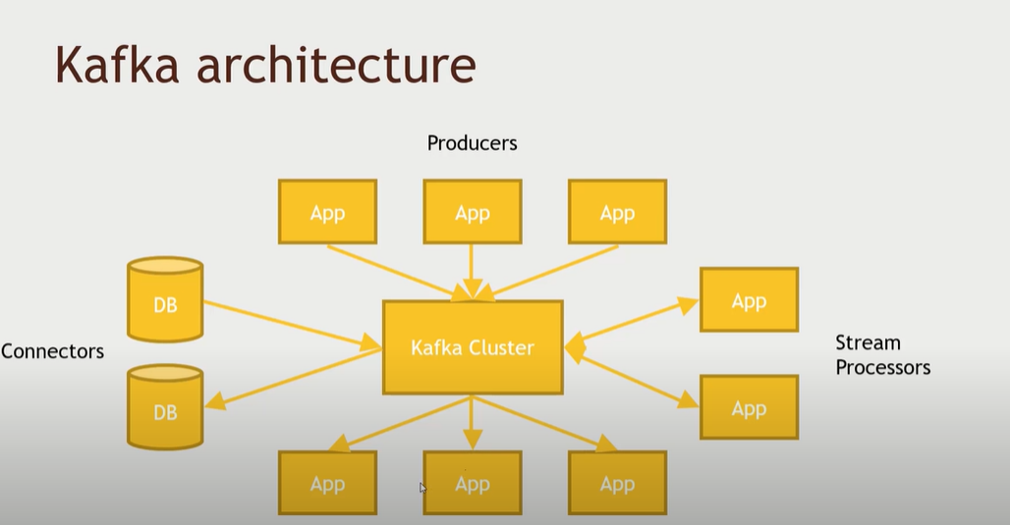

Slide 32
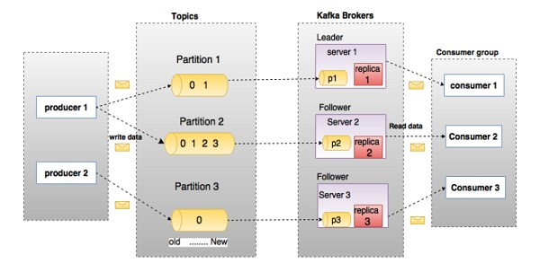

Slide 33
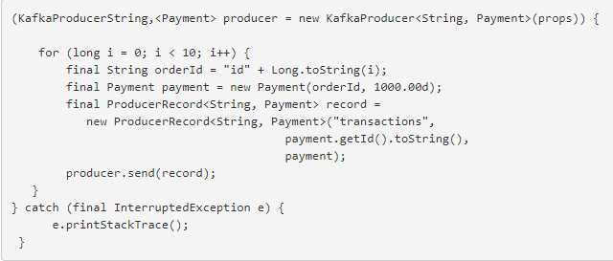
Producer Example
Whether you know it or not yet, you're extremely happy someone wrote this library for you. try

Slide 34
Kafka Consumer
Using the consumer API is similar in principle to the producer.
You use a class called KafkaConsumer to connect to the cluster (passing a configuration map to specify the address of the cluster, security, and other parameters).
Then you use that connection to subscribe to one or more topics.

Slide 35
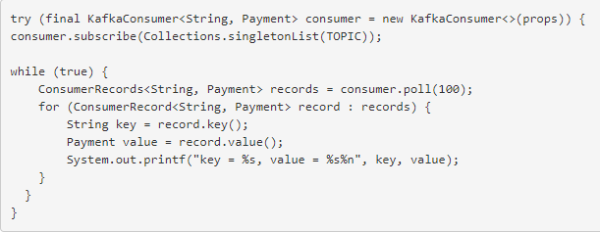
When messages are available on those topics, they come back in a collection called ConsumerRecords, which contains individual instances of messages in the form of ConsumerRecord objects.
A ConsumerRecord object represents the key/value pair of a single Kafka message.

Slide 36
KafkaConsumer manages connection pooling and the network protocol just like KafkaProducer does, but there is a much bigger story on the read side than just the network plumbing.
First of all, Kafka is different from legacy message queues in that reading a message does not destroy it; it is still there to be read by any other consumer that might be interested in it.
In fact, it’s perfectly normal in Kafka for many consumers to read from one topic.

Slide 37
This one small fact has a positively disproportionate impact on the kinds of software architectures that emerge around Kafka, which is a topic covered very well elsewhere.
Also, consumers need to be able to handle the scenario in which the rate of message consumption from a topic combined with the computational cost of processing a single message are together too high for a single instance of the application to keep up.
That is, consumers need to scale. In Kafka, scaling consumer groups is more or less automatic.

Slide 38
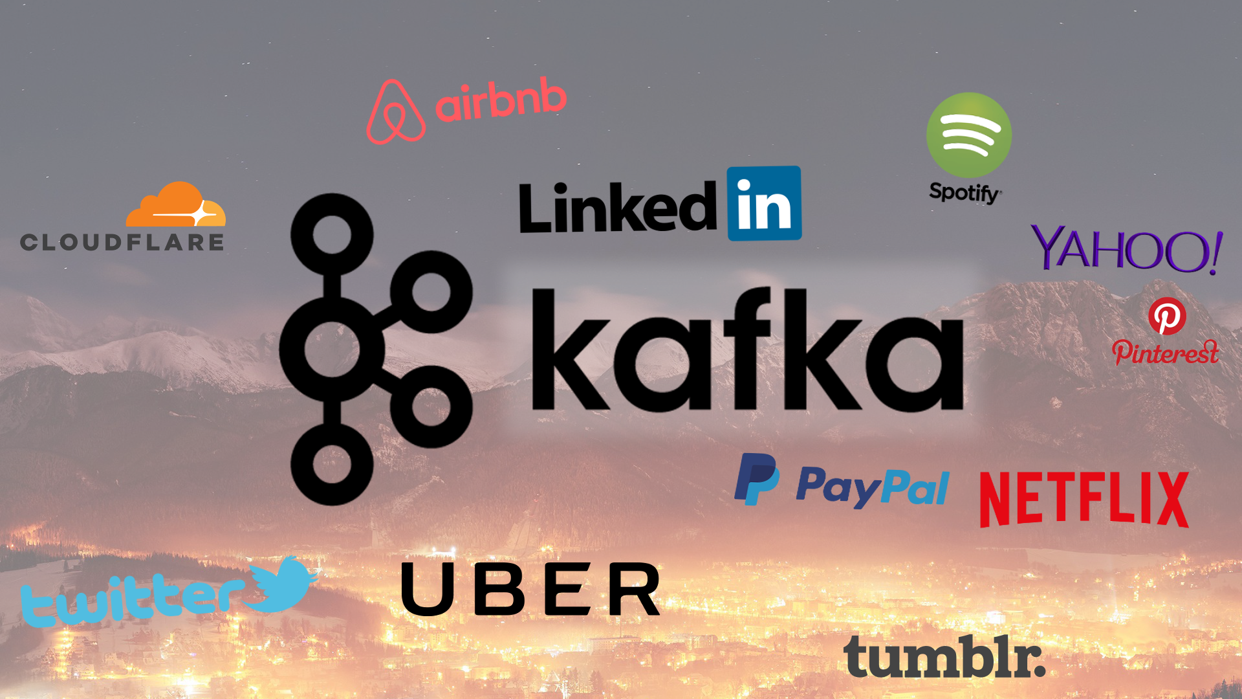

Slide 39
END OF SESSION
Q&A

